Slide 1
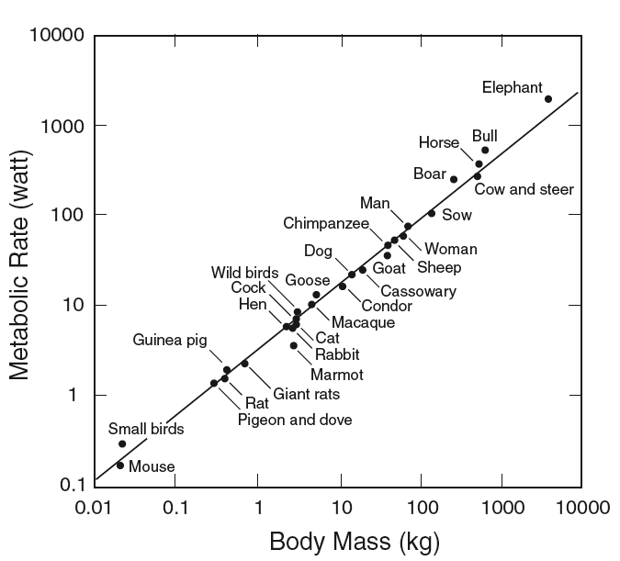
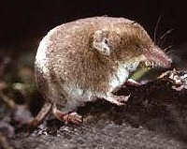
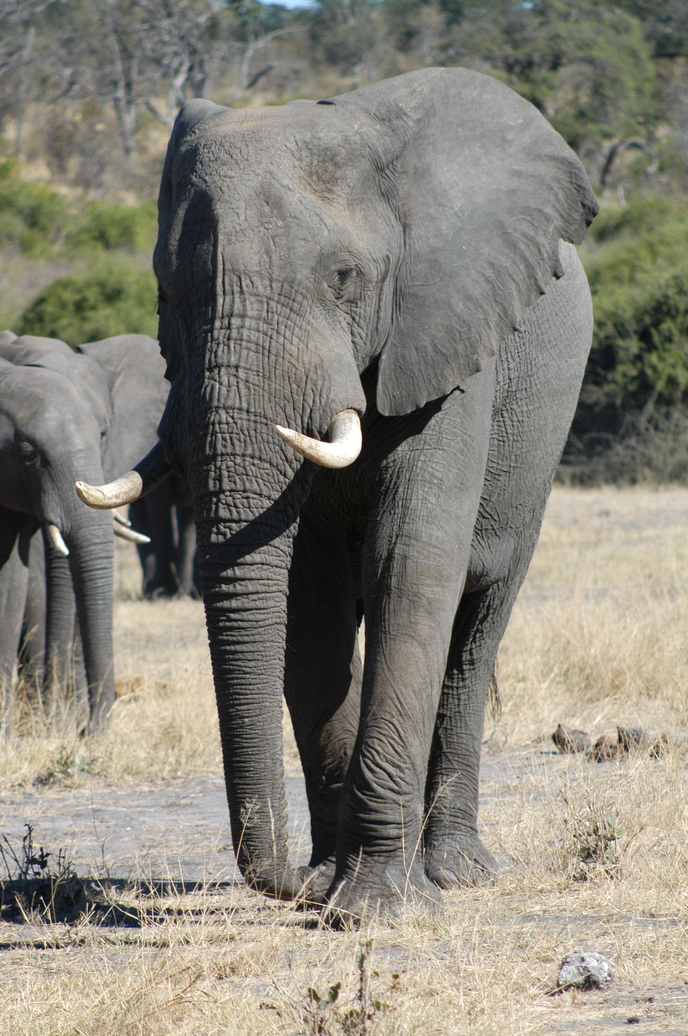
SLOPE = ¾ < 1

Slide 2
SLOPE = ¾ < 1 SUB-LINEAR
(KLEIBER’S LAW 1932)

Slide 3
SLOPE = ¾ < 1 SUB-LINEAR ECONOMY OF SCALE
(KLEIBER’S LAW 1932)

Slide 4
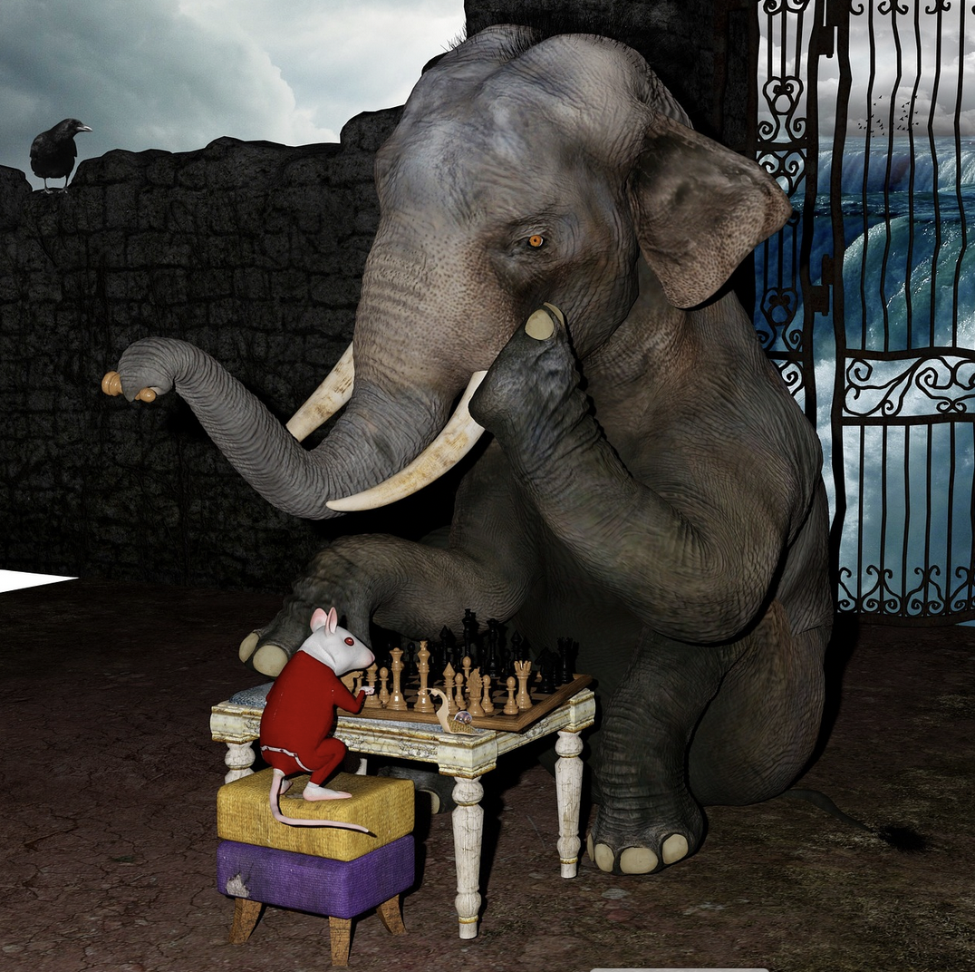
THE NUMBER (10¹⁶) OF INDIVIDUAL CELLS (THE TOTAL BIOMASS) IN A SINGLE ELEPHANT IS EQUIVALENT TO APPROXIMATELY 20,000 INDIVIDUAL MICE

Slide 5
THE NUMBER (10¹⁶) OF INDIVIDUAL CELLS (THE TOTAL BIOMASS) IN A SINGLE ELEPHANT IS EQUIVALENT TO APPROXIMATELY 20,000 INDIVIDUAL MICE
BUT THE SINGLE ELEPHANT REQUIRES ONLY ABOUT 25,000 FOOD CALORIES A DAY TO STAY ALIVE WHEREAS THE 20,000 MICE REQUIRE ABOUT 500,000 FOOD CALORIES! A FACTOR OF 20 TIMES MORE!

Slide 6
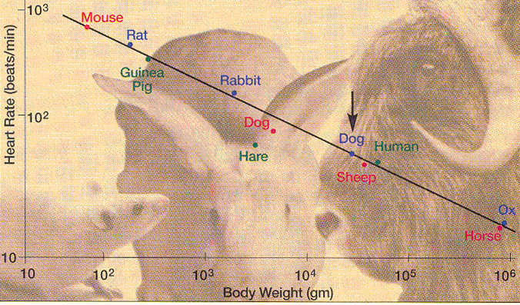
Metabolic rate sets the pace of life
Small animals live fast and die young
heart rate scales as
-1/4 power of body mass

Slide 7
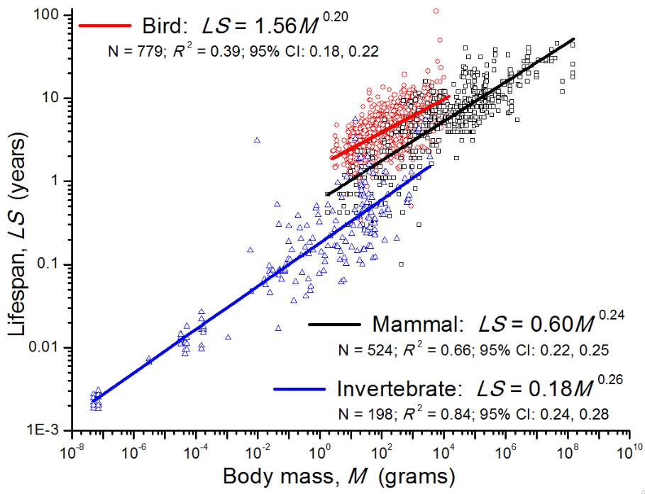

Slide 9
H.J. Levine, J Am Coll Cardiol 19,1997;30:1104–6

Slide 10
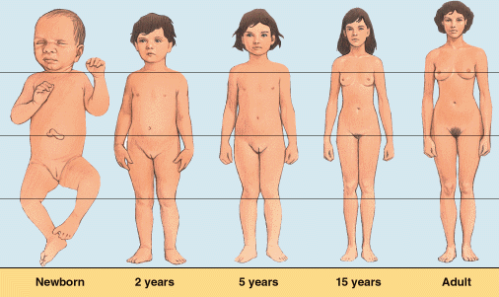
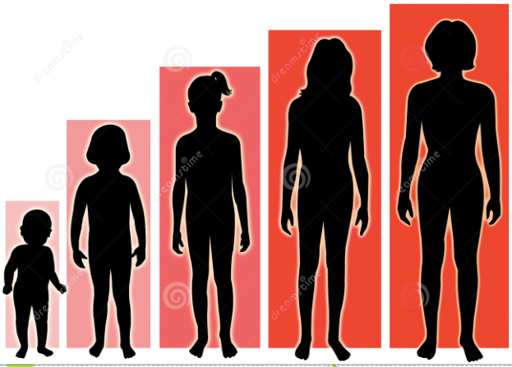
GROWTH

Slide 11
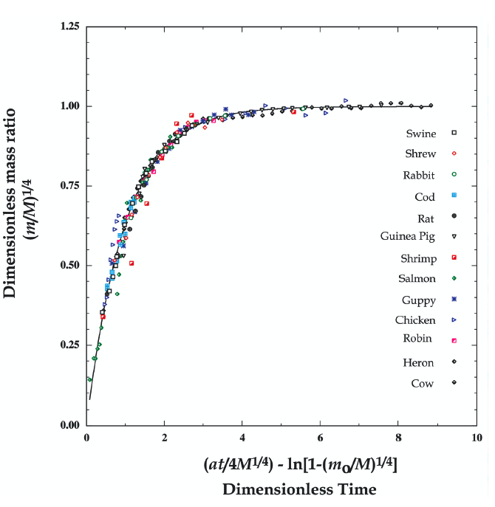
UNIVERSAL COLLAPSED GROWTH CURVE
RESCALED MASS VS. RESCALED AGE

Slide 12
HIDDEN LAWS OF BIOLOGY HIDDEN LAWS OF CITIES
INFRASTRUCTURE
SUB-LINEAR SCALING
ECONOMY OF SCALE
C. Kuhnert, D. Helbing & G.B. West, Physica A (2005)

Slide 13
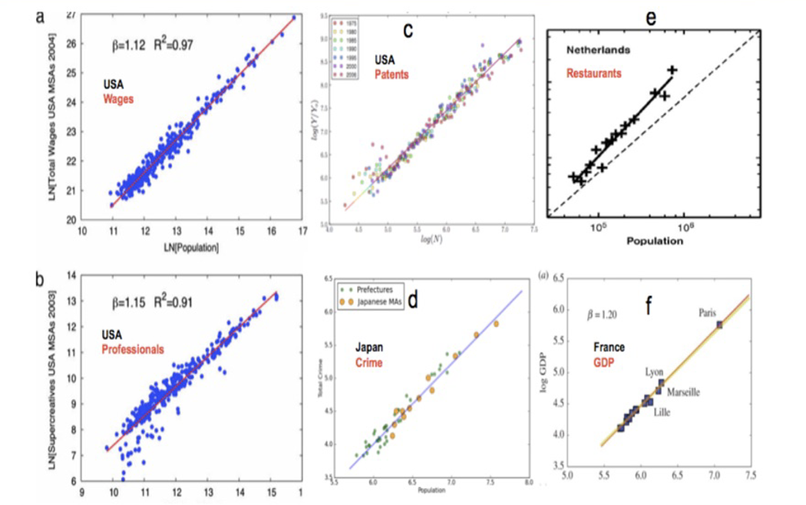
UNIVERSALITY OF URBAN SCALING
Sweden
L.M.A. Bettencourt, D. Helbing, C. Kuhnert, J. Lobo, G.B. West PNAS, 2007 104 (17) 7301

Slide 15
L.M.A. Bettencourt, D. Helbing, C. Kuhnert, J. Lobo, G.B. West PNAS, 2007 104 (17) 7301

Slide 16
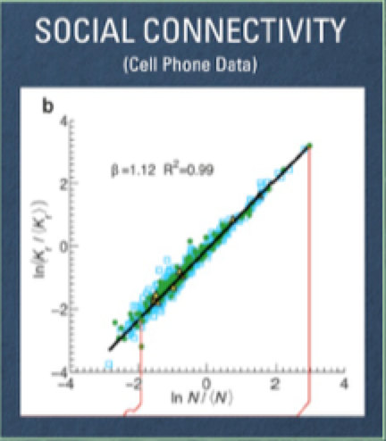
M. Schlapfer, L.M.A.Bettencourt, M. Raschke, R, Claxton, Z. Smoreda, G.B. West, C. Ratti
J. R. Soc. Interface 11 (98), 20130789 (2014)

Slide 17
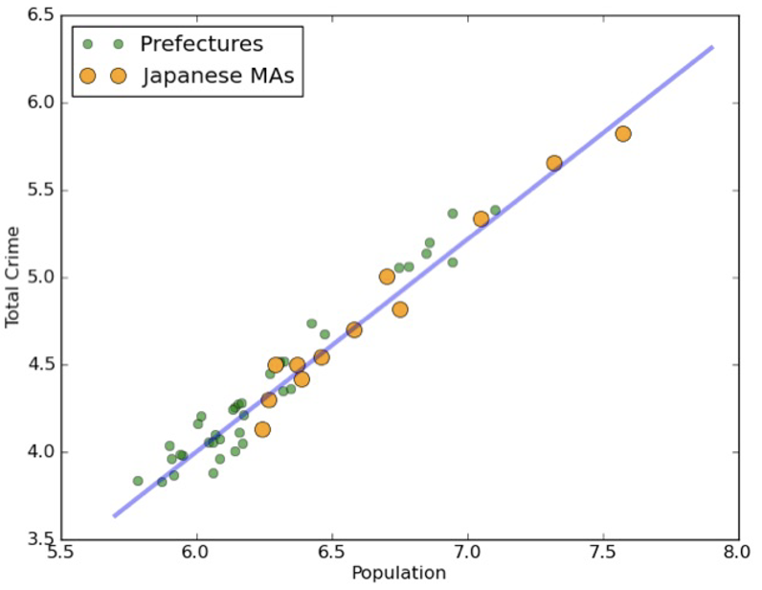
CRIME (1.2)

Slide 18
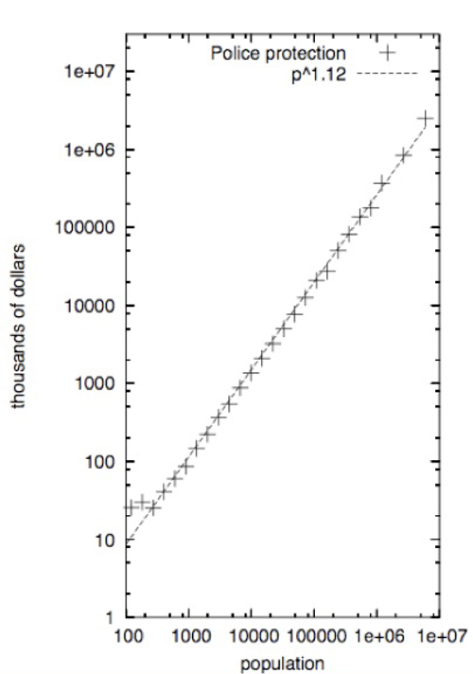
POLICE (1.12)
CRIME (1.2)

Slide 19
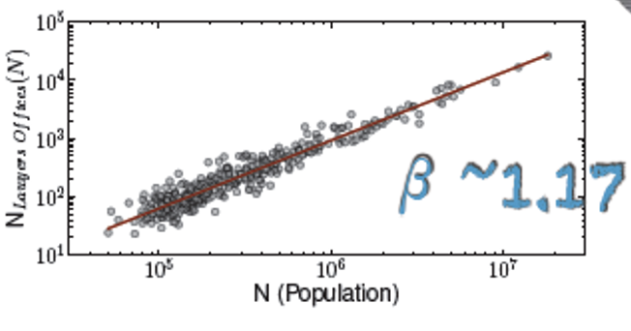
POLICE (1.12)
LAWYERS
CRIME (1.2)

Slide 20
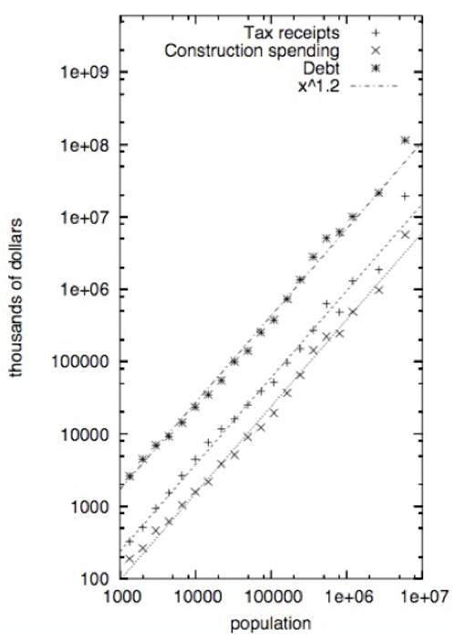
POLICE (1.12)
TAXES (1.2)
DEBT
LAWYERS
CRIME (1.2)

Slide 21
ACTIVE METABOLIC RATE
SLOPE = ¾ < 1 SUB-LINEAR ECONOMY OF SCALE

Slide 22
* MODERN SOCIO-
ECONOMIC HUMAN
ACTIVE METABOLIC RATE
SLOPE = ¾ < 1 SUB-LINEAR ECONOMY OF SCALE

Slide 24
(ABOUT 30 TONS!!)

Slide 26
Creating slide
UNBOUNDED GROWTH REQUIRES ACCELERATING CYCLES OF INNOVATION TO AVOID COLLAPSE

